Slide 1
IMPROVING THE RUNGE KUTTA METHOD
A Project by ~
Keshav Singh (2K19/EE/134)

Slide 2
Introduction
While sending a satellite to another planet, it is often necessary to make a course correction mid-way. The differential equations governing the motion are well known, the projected path can be calculated by solving the differential equations concerned. This is just one example where we use differential equations. Differential equations are of a great use in real life, governing everything from motion to The Laws of Thermodynamics. So it becomes extremely important to be able to solve these equations correctly and with precision. There are various tools/methods that come handy when it comes to solving differential equations, the Runge Kutta Method is one of them.

Slide 3
AIM of the PROJECT
In this project we focus on increasing the accuracy as well as performance of Runge-Kutta method in solving Differential Equations.
To increase the accuracy we take the order of Runge-Kutta method two steps ahead. We were introduced upto 4 orders of Runge-Kutta Method in our classes, but here we take it forward to two more orders introducing 5th and 6th order Runge-Kutta Methods.
To enhance the performance of Runge-Kutta Methods we will implement an adaptive step-size modulation in the Runge-Kutta algorithm using which the program will accordingly alter the step size intelligently to reduce calculation time without compromising with the accuracy.

Slide 4
Need for the topic
As discussed in Introductory slide, Runge-Kutta methods are used to solve differential equations governing the path of motion of satellites, where a mistake of even the order of 10⁻⁹ can lead to a massive disaster. So it becomes extremely necessary to constantly be updated with the algorithms that provide us with most accurate results. Currently, 4th order Runge Kutta method is the most accurate algorithm for finding the solutions of a differential equation. So in this project, we’re going to try to improve the accuracy as well as performance of the Runge-Kutta Methods.

Slide 5
Runge kutta method
Runge-Kutta methods are a class of implicit and explicit iterative methods which judiciously uses the information on the 'slope' at more than one point and making use of temporal discretization for approximating the solutions of ordinary differential equations.
These methods were developed around 1900 by the German mathematicians Carl Runge and Wilhelm Kutta.
This method is by far gives the most accurate output, so much so that it is used in most of the online calculators.

Slide 6

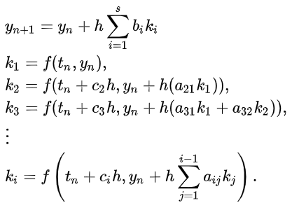
Implicit Runge-Kutta Method
Runge–Kutta methods are methods for the numerical solution of the ordinary differential equation
Explicit Runge-Kutta methods take the form

Slide 7

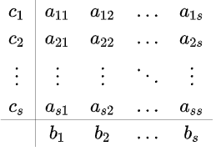
Stages for implicit methods of s stages take the more general form
Each method is defined by its Butcher tableau, which puts the coefficients of the method in a table as follows:

Slide 8
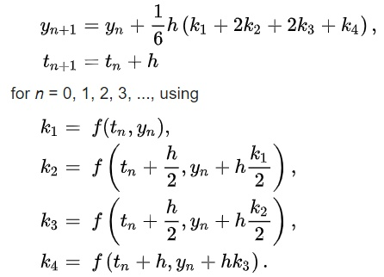
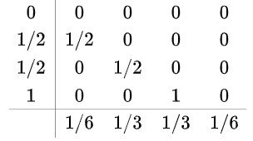
Butcher’s Tableau for RK4
Classical RK-4 method uses the following Butcher Tableau for solving a Differential Equation

Slide 9
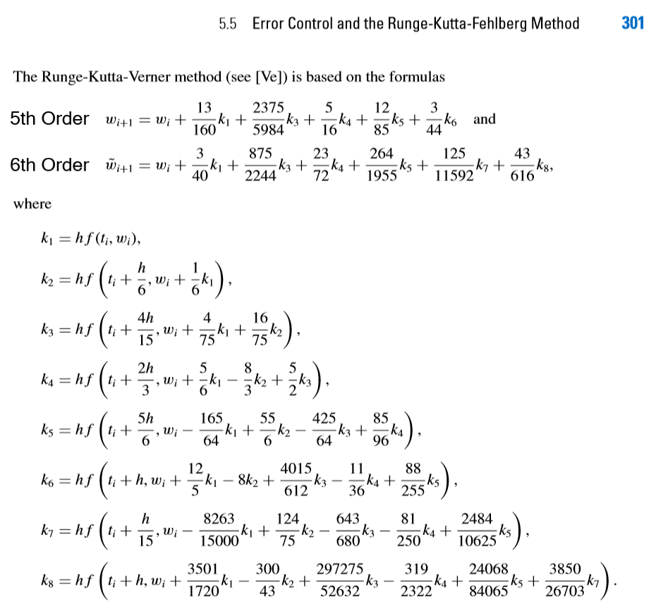
RK-5 and RK-6 working formula
This is a cropped image of the working formula for Runge-Kutta 5th and 6th order Methods from the book
“Numerical Analysis” 9th Edition by ~
Richard L. Burden
Youngstown State University
J. Douglas Faires
Youngstown State University
**Original Formula was developed by
JH. Verner

Slide 10

Problem Definition
given at x=0, y=2.17928556.
Find y at x=1.
On solving manually,
Solution : y(1) = 2.6932

Slide 11
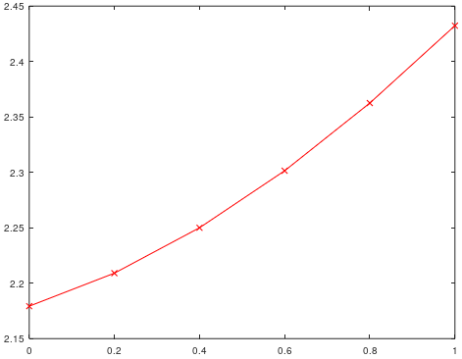
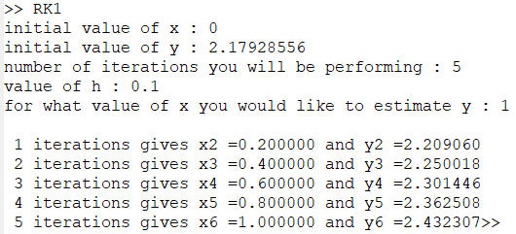
First order method

Slide 12
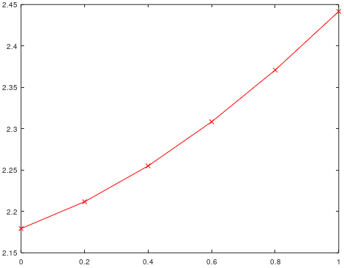
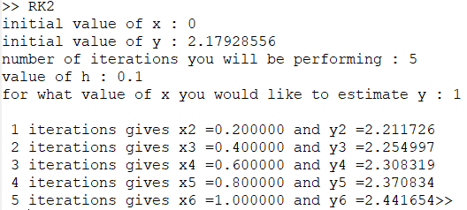
Second order method

Slide 13
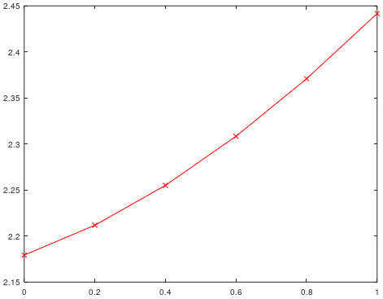
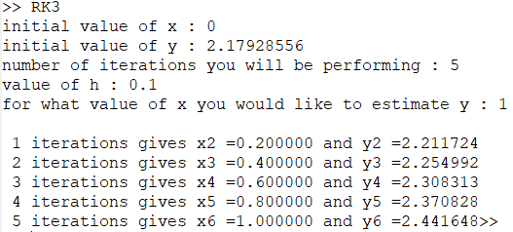
Third order method

Slide 14


Fourth Order Method

Slide 15
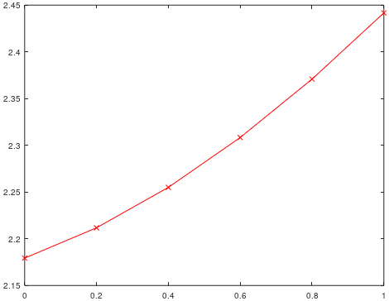

Fifth order method

Slide 16

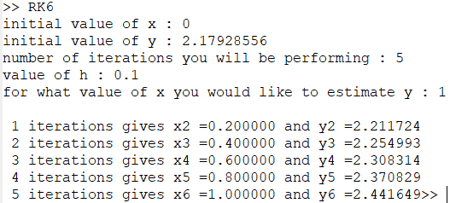
Sixth Order Method

Slide 17
Observation Table
We implemented Runge-Kutta orders 1-6 all of them using a 5 step algorithm with step size =0.1 for purpose of comparison and these were the final values of y(1) estimated ~
METHOD | y(1)
RK-1 | 2.432307
RK-2 | 2.441654
RK-3 | 2.441648
RK-4 | 2.441649
RK-5 | 2.441649
RK-6 | 2.441649

Slide 18
Observations
From the results, we observe that the most optimum algorithm for solving a differential equation is the RK-4 method.
In some cases,like this RK-2 method might dominate, but mostly, RK-4 dominates.
What’s interesting to observe is that the results do not get better if we increase the order of algorithm, i.e. 5th and 6th runge kutta method generate the same result as RK-4.
But by increasing the order of the algorithm, we increase the computational stages and thus increasing time of calculation.
Hence, the most optimum algorithm for solving a differential equation is the RK-4 method.

Slide 19
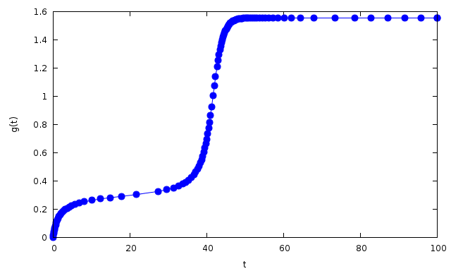
What is Adaptive Step-Size Modulation ?
Considering the Function g(t) given below, we can see that for 10<t<30 the function is almost flat and increasing the step-size won’t affect the results a lot.
But for 30<t<50, the function is rather steep and reducing the step size would yield a better result.
Therefore, implementing an adaptive step-size algorithm which can alter the step-size intelligently according to slope values in each iteration without human intervention could definitely yield a
Better performing Runge-Kutta Differential Equation Solver.

Slide 20
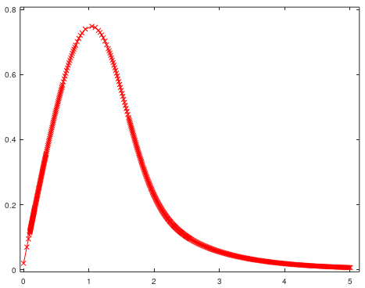
An example to understand step size modulation better.
Example Problem : dy/dx =e^{y}-y.e^{x}
Initial Conditions : Y(0)= 0.02
To evaluate : y(5)
Observation : Step size i.e. gap between successive steps is changing throughout the curve intelligently to evaluate the result without human intervention.

Slide 21
Our Initial Problem
given at x=0, y=2.17928556.
Find y at x=1.
On solving manually,
Solution : y(1) = 2.6932

Slide 22
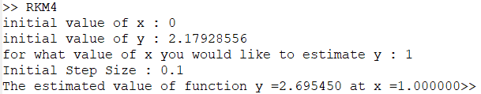
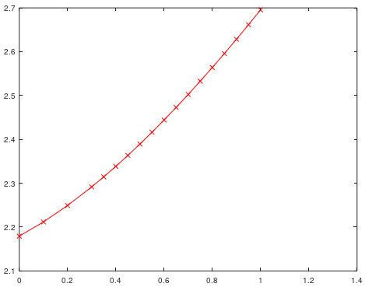
Runge Kutta 4 with step size modulation
The plot of y vs x depicts the change in step size which is decreasing with increase in slope.

Slide 23
Final Comparison of Results.
 | RK-4 Method Answer | RK-4 with adaptive step size modulation
Calculated Answer | 2.441649 | 2.695450
Actual answer on solving manually | 2.6932 | 2.6932
No. of steps | 5 | 17
Initial Step Size | 0.1 | 0.1
Error % | 9.3402% | 0.0835

Slide 24
Final Conclusions
The RK4 method is the best among other orders of Runge Kutta Method when considering accuracy as well as performance.
When Intelligent step size modulation was added to the RK4 algorithm the accuracy increased a lot while compromising a little on calculation speed for the problem under consideration
The new error was 0.0835 % compared to an error of 9.3402 % without step size modulation.
Our aim to improve Runge Kutta Method was achieved by applying step size modulation to RK4 algorithm.

Slide 25
References
“Numerical Analysis” 9th Edition by ~
Richard L. Burden & J.Douglas Faires
Youngstown State University Youngstown State University
www.wikipedia.com
www.stackexchange.com
www.octave.sourceforge.io
www.ieeexplore.ieee.org

Slide 26
ACKNOWLEDGEMENT
This project wouldn’t have had been possible without the help of
Mrs. Uma Nangia Ma’am [HOD,Electrical Department, DTU ]
I would like to heartily thank Uma Nangia Ma’am for providing me with this idea of project and guiding me through the course of creation of this program.

Slide 27
Thank You

